Slide 2
Every day
You will come to school on your minibuses
You will go home on your minibuses

Slide 3
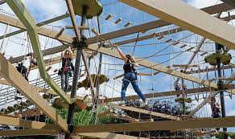
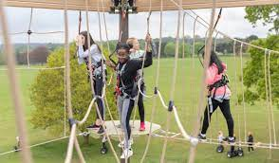
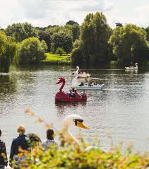
Monday 17th July Skyline/Dinogolf/Boating – Mote park
Timetable for day
9- Leave school
10.00– skyline/dinogolf
11-12:45 – lunch (picnic) / games
1-2 – boats
2:45- school return

Slide 4
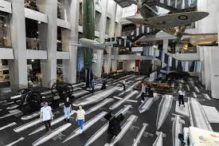
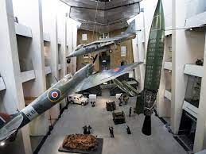
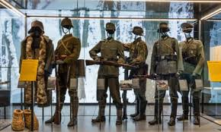
Tuesday 18th July
Food available
Timetable for day
Leave school asap
10-14:00 Imperial War Museum
Return to school at 2:45

Slide 5
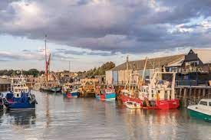
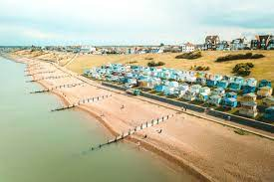
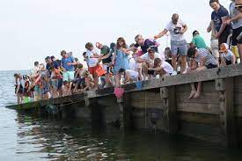
Wednesday 19th July Whitstable
Food available
Timetable for day
9:30 leave school
Beach / Crabbing
12:00 Lunch
14:00 Return to school

Slide 6
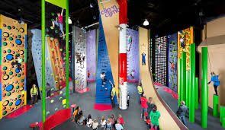
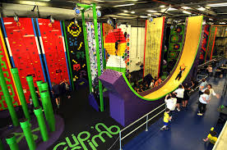
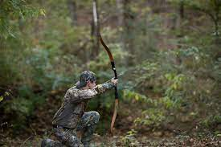
Thursday 20th July ClipNClimb - Archery
Timetable for day
9:15am leave school
Arrive 9:45am
10am climb/Archery
11:45 lunch
1pm Archery/Climb
2:30pm return to school

Slide 7
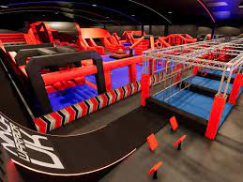
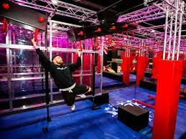
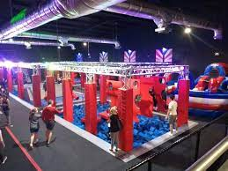
Friday 21th July Ninja Warrior / Brunch
Timetable for day
9:15- Morning Form Time
10-12 –Assembly/Brunch
12:00- Leave School
12:30-2:30 – Ninja Warrior
2:30–3:00 – Form Time / Goodbyes

Slide 8
Money
It will cost £60 for the whole week- you have all paid already
You can bring Spending money every day

Slide 9
Food
You will need packed lunch on:
Monday and Thursday-
You will have no facilities to heat food
On the other days there will be facilities to buy food.
Only on Tuesday/Wednesday can we guarantee somewhere to purchase food.

Slide 10
Phones
These are normal school length days so phones are NOT allowed.
You will put them in the tin as normal when you come in the mornings

Slide 11
Staffing and seating plans will be shared on the day.
Groupings
Group 1
Leo
Kian
Lily
Ash
Thomas
Alfie
Group 2
Michael
Joseph
Muhaymin
Josh
Rossi

